Slide 1
Mobile Application Development
Lecture 1

Slide 2
Different ways to Build Mobile Apps
Using Native SDKs
Android – Java programming language
iOS – Swift, Objective C.
Hybrid App Development Ionic Framework, React Native, Flutter.

Slide 3
Different ways to Build Mobile Apps
Using Native SDK
A Native app is built for a particular device and its operating system.
Native mobile app code runs faster.
Seperate codebases. Need to learn for Android and iOS separately. Not easy to find experienced developers because of this.

Slide 4
Different ways to Build Mobile Apps
Using Native SDK
For Android app, you need to learn Java. For iOS, you need to learn either Swift or Objective C.
For building native iOS apps, you need a Mac book.
Eventually this becomes expensive.

Slide 5
Different ways to Build Mobile Apps
Using Hybrid Approach
Hybrid Apps have a single codebase for both Android and iOS apps.
You only need to know web technologies (HTML, CSS, JavaScript) to build hybrid mobile apps using Ionic Framework or React Native.
Flutter (built by Google) uses Dart language.

Slide 6
Why Hybrid approach?
Single codebase for both Android and iOS.
Only need to know JavaScript. One language.
Cost effective as you don’t need separate experienced Swift and Java developers.
Shorter time to market.
Alot of companies (especially startups) are adopting this model.

Slide 7



Ionic vs React Native vs Flutter
 | Ionic | React Native | Flutter
Language | HTML / CSS /JavaScript | HTML / CSS /JavaScript | Dart
UI Framework | Angular / React / Vuejs / Vanilla JS | React JS | -
Uses WebView | Yes | No | No
Founded | 2013 | 2015 | 2017
Ideal for intense graphic apps? | No | Moderately | Yes

Slide 8
“Any fool can learn from experience. The trick is to learn from other people’s experience. ~ Otto Von Bismarck”

Slide 9
Introduction to Ionic
Ionic Framework is the free, open source mobile UI toolkit for developing high-quality cross-platform apps for native iOS, Android, and the web—all from a single codebase.
Ionic can be used with any JS Framework. Angular / React / Vuejs / or even Vanilla JS.
Very fast development speed. Incredibly fast to prototype and build native looking apps.
Ionic uses WebView. Which means an Ionic app runs inside a hidden browser (headless browser). This is its major difference with React Native and Flutter.

Slide 10
Introduction to Ionic
Does running in webview affect performance? Not much. It’s a very minute difference in performance due to webview and 99% of the times, you won’t notice it.
Ionic apps are mostly built in Angular because it provides an official integration with Angular.
Ionic Framework is built with simplicity in mind.
Ionic Framework has a very strong ecosystem.

Slide 11
Prerequisites ( to install/configure)
Node.js https://nodejs.org/en/ (version 10+. Ideally 10.16 LTS)
Git https://git-scm.com/downloads
Github account https://github.com/ (signup if you haven’t already)
Cmder (terminal) https://github.com/cmderdev/cmder
VSCode (https://code.visualstudio.com/)

Slide 12
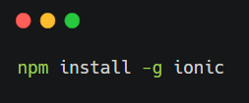
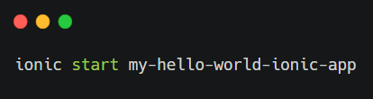
Lets start by building a hello world Ionic App
Step 1
Step 2

Slide 13
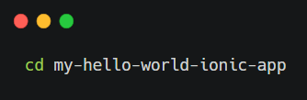
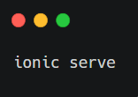
Lets start by building a hello world Ionic App
Step 3
Step 4

